Slide 1
Weekly Spelling tasks

Slide 2



Task 1 – read and copy
Read word lists in your head and out loud
Copy word lists into your spelling book
Put word lists in your bag to take home

Slide 3
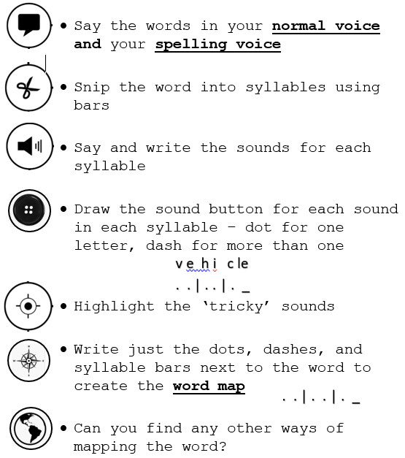
Task 2 – Sound and syllable
Sound and syllable the words

Slide 4

Task 3 – compare how they look
Compare – same and different letter combinations
Words with ‘augh’
Words with ‘augh’
naughty
caught
naughty
caught
daughter
draught
daughter
draught
fraught
laugh
fraught
laugh
distraught
taught
distraught
taught

Slide 5

Task 3 – compare how they sound
Compare – same and different sounds
‘augh’ as /or/
Words with ‘augh’
‘augh’ as /a/+/f/
naughty
caught
naughty
caught
daughter
draught
daughter
draught
fraught
laugh
fraught
laugh
distraught
taught
distraught
taught

Slide 6
Task 4 – group and structure
Group same sound combinations
‘augh’ as /or/
‘augh’ as /a/+/f/
naughty
caught
naughty
caught
draught
draught
daughter
daughter
taught
taught
laugh
laugh
fraught
fraught
distraught
distraught

Slide 7

Task 5 – generalise
Generalise any patterns you might spot
Generalisation - unchanged root words end with -able
Words with ‘able’
Words with ‘ible’
acceptable
acceptable
horrible
affordable
affordable
impossible
questionable
questionable
edible
tolerable
terrible
tolerable

Slide 8
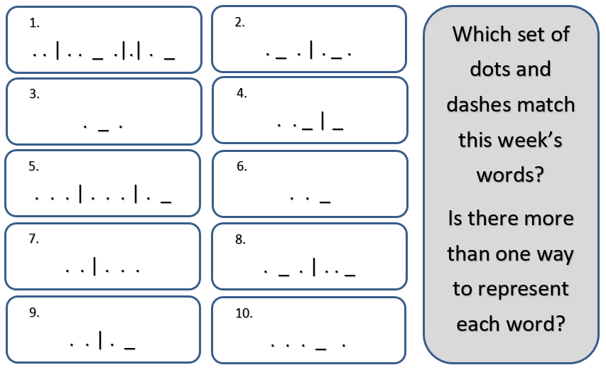
Task 6 – reasoning sheets
Reason as to how the words could be word mapped
Find more than one way if
you can
Decide on the most
common/reasonable way you
are confident with

Slide 9

Task 7 – find similar words
Find – other words with the same letter combinations
Words with ‘augh’
Words with ‘augh’
More words with ‘augh’
caught
naughty
onslaught
daughter
draught
slaughter
haughty
fraught
laugh
distraught
taught

Slide 10
Task 8 – Identify root words
Identify root words in words
Identify root words in words
undecided
undecided
laughed
laughed
planned
planned

Slide 11
Task 8 – Identify and change word classes
Identify the word classes
Change them by adding or removing prefixes or suffixes
Words with ‘augh’
Word class =
New word -
caught
= verb
caught
= X
daughter
= common noun
daughter
= X
distraught
= adjective
distress
= abstract noun
laugh
= verb or noun
laughing
= verb

Slide 12
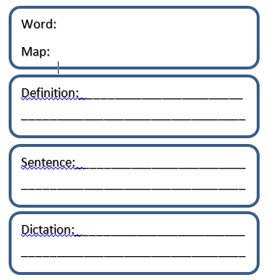
Task 9 – word cards
Find definitions using the dictionary
Write your own sentences
Dictate sentences to a partner
Write partner’s sentences

Slide 13
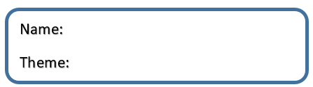
Task 10 – Create sentences
Create sentences using this week’s chosen theme
Nominate a theme that could fit the week’s spelling words well

Slide 14
Task 11 – Practice in pairs
Practice by playing ‘Guess Who’ or ‘Hang Man’

Slide 15
Task 12 – test in pairs
Test each other
Use white boards
Both of you must Sound and Syllable the words
Take it in turns to pick a word from either word list that week

Slide 16
